Slide 1
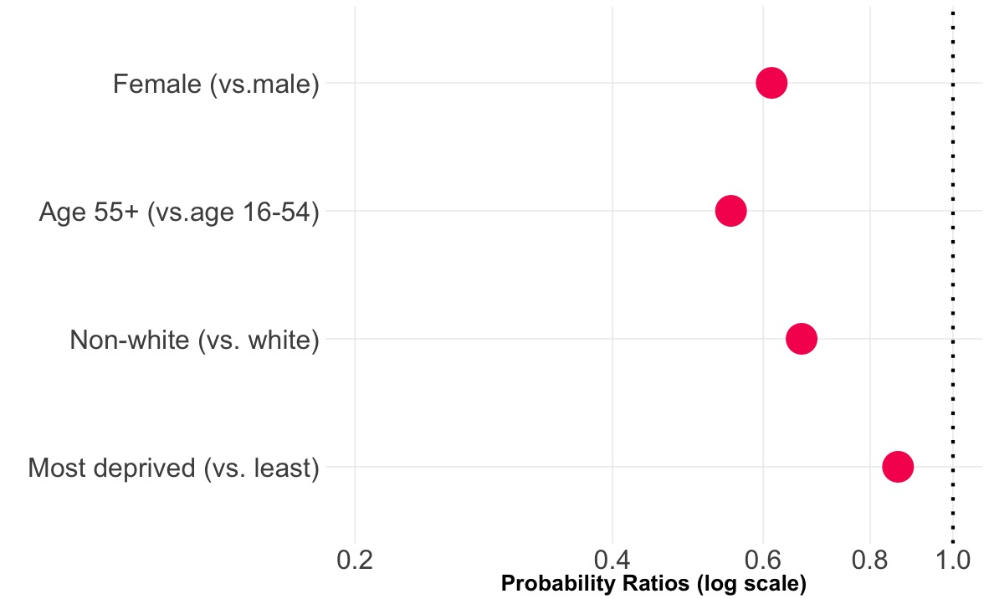
Less likely
Females are 0.61 as likely as males to cycle

